Slide 1

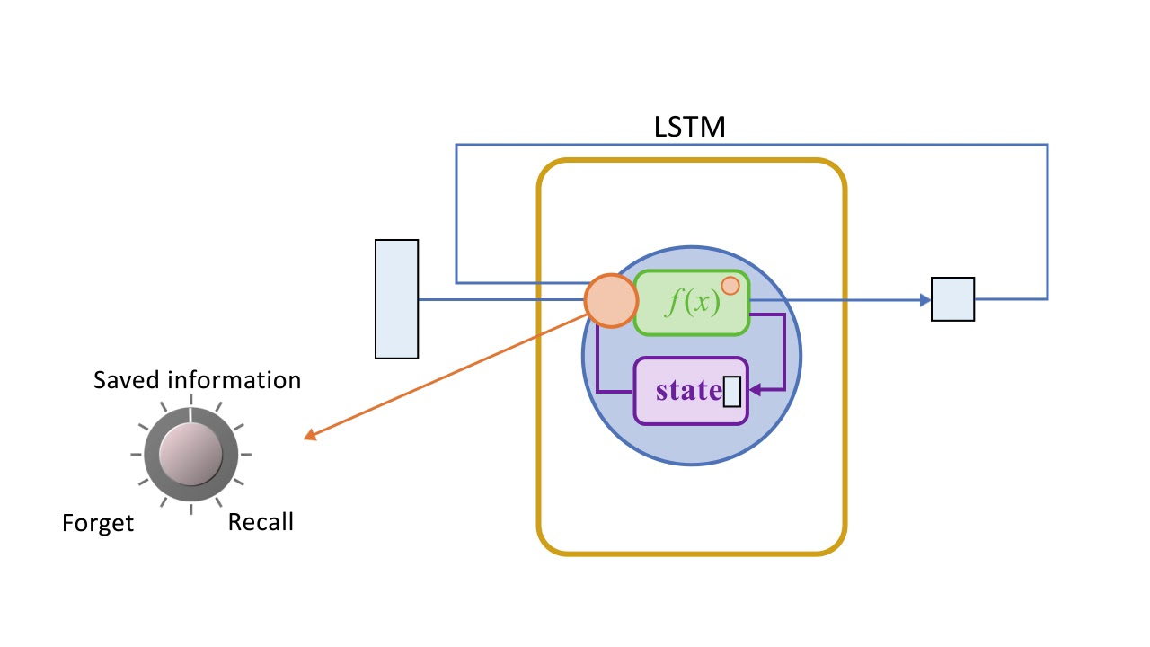
Electricity Price Prediction
Using LSTM

Slide 2

Contents
Part 1
Introduction
Part 2
Steps involved
Part 3
How to solve LSTM based problems
Part 4
Conclusion

Slide 3
Introduction:
Long Short-Term Memory Networks is a deep learning, sequential neural network that allows information to persist. It can be used to predict electricity price

Slide 4
Steps involved:
03
Solving using LSTM
01
Data analysis
02
Data
Preprocessing

Slide 5
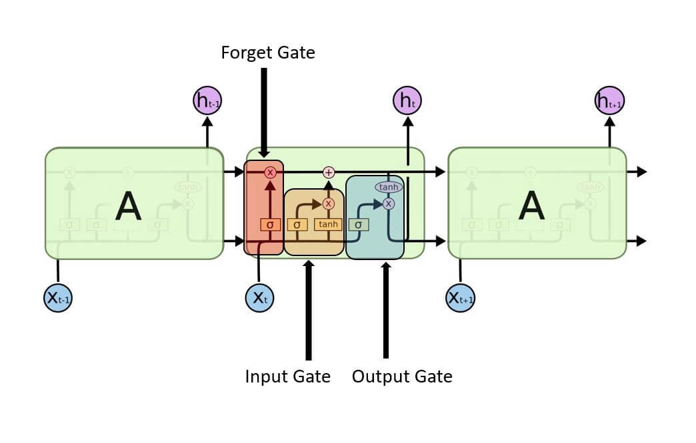
How to solve LSTM Poblems:

Slide 6

Input gate:
It determines which of the input values should be used to change the memory. The sigmoid function determines whether to allow 0 or 1 values through. And the tanh function assigns weight to the data provided, determining their importance on a scale of -1 to 1.
Input Gate | Long Short Term Memory

Slide 7
Forget Gate:
It finds the details that should be removed from the block. It is decided by a sigmoid function. For each number in the cell state Ct-1, it looks at the preceding state (ht-1) and the content input (Xt) and produces a number between 0 (omit this) and 1 (keep this). Forget Gate | Long Short Term Memory

Slide 8

Output Gate:
The block’s input and memory are used to determine the output. The sigmoid function determines whether to allow 0 or 1 values through. And the tanh function determines which values are allowed to pass through 0, 1. And the tanh function assigns weight to the values provided, determining their relevance on a scale of -1 to 1 and multiplying it with the sigmoid output.

Slide 9
Conclusion:
Long short-term memory (LSTM) is a deep learning architecture based on an artificial recurrent neural network (RNN). LSTMs are a viable answer for problems involving sequences and time series.

